Slide 1
God’s Toolbox

Slide 2
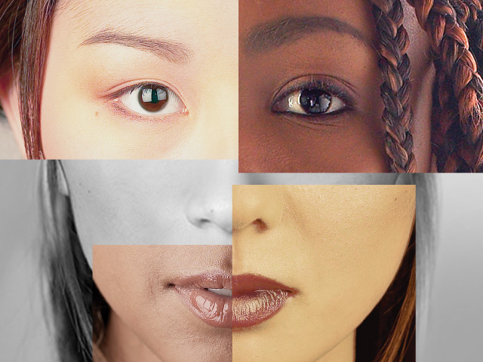
Race

Slide 3
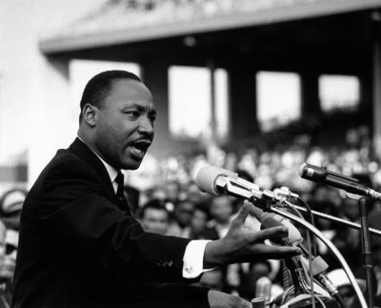
It is appalling that the most segregated hour of Christian America is 11 o’clock Sunday Morning

Slide 4
Genesis 1:27
So God created man in his own image,
in the image of God he created him;
male and female he created them.

Slide 5
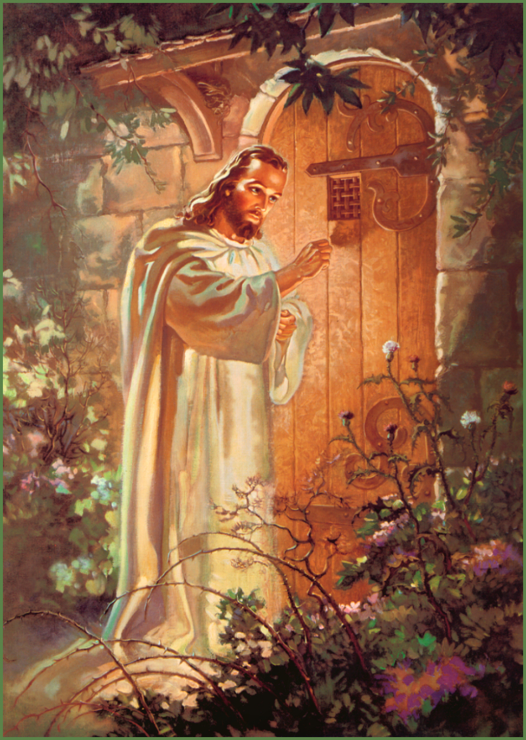

Slide 6
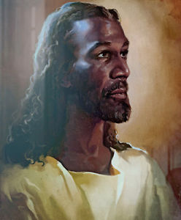

Slide 7
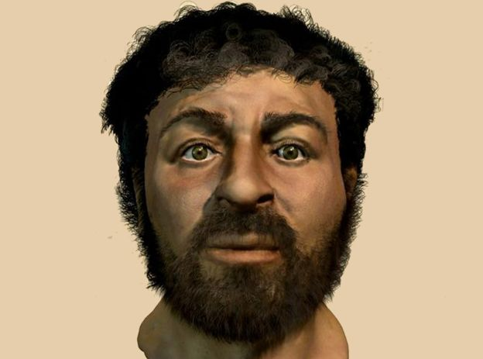

Slide 8
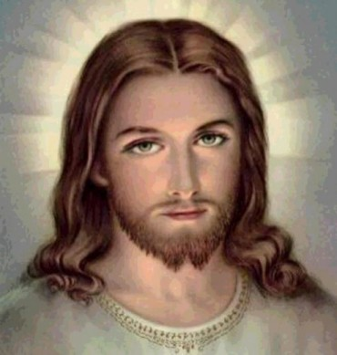

Slide 9
Galatians 3
23 Now before faith came, we were held captive under the law, imprisoned until the coming faith would be revealed. 24 So then, the law was our guardian until Christ came, in order that we might be justified by faith. 25 But now that faith has come, we are no longer under a guardian, 26 for in Christ Jesus you are all sons of God, through faith.27 For as many of you as were baptized into Christ have put on Christ.

Slide 10
28 There is neither Jew nor Greek, there is neither slave nor free, there is no male and female, for you are all one in Christ Jesus.

Slide 11
Deuteronomy 10
¹⁷ For the Lord your God is the God of gods and the Lord of lords, the great, the mighty, and the awesome God who does not show partiality nor take a bribe. ¹⁸ He executes justice for the orphan and the widow, and shows His love for the alien by giving him food and clothing. ¹⁹ So show your love for the alien, for you were aliens in the land of Egypt.

Slide 12
We should be Colorblind in Christ

Slide 13
Genesis 1
²⁸ And God blessed them. And God said to them, “Be fruitful and multiply and fill the earth and subdue it.”

Slide 14
Revelation 7
⁹ After this I looked, and behold, a great multitude that no one could number, from every nation, from all tribes and peoples and languages, standing before the throne and before the Lamb, clothed in white robes, with palm branches in their hands, ¹⁰ and crying out with a loud voice, “Salvation belongs to our God who sits on the throne, and to the Lamb!”

Slide 15
Celebrate Diversity

Slide 16
Celebrate Diversity
Listen and Learn

Slide 17
Celebrate Diversity
Listen and Learn
Repent when you mess up

Slide 18
Celebrate Diversity
Listen and Learn
Repent when you mess up
Give up Rights and Privilege for Love

Slide 19


Slide 20
Celebrate Diversity

